Slide 1
Never Too Late: Tracing and Mitigating Backdoor Attacks in Federated Learning
The 41st International Symposium on Reliable Distributed Systems (SRDS 2022)
Hui Zeng, Tongqing Zhou, Xinyi Wu, Zhiping Cai
National University of Defense Technology, China
国防科技大学
National University of Defense Technology
Notes:
Ok let’s begin our presentation.
My name is Hui Zeng, I am from National University of Defense Technology, China.
Today, I would like to present our work “Never too late: Tracing and Mitigating Backdoor Attacks in Federated Learning”.

Slide 2
A Chinese Idiom
Sheepfold
Wolf
Crack
“It’s never too late to mend the fence when you find a sheep stolen by the wolf. ”
“It’s never too late to mitigate the model backdoors when you find a federated learning model has been attacked by attackers. ”
Notes:
let start with a chinese idiom /idiem/
Once upon a time, someone raise a dozens of sheep.
One night, the wolf catch a sheep through a unconspicuous /un conspi ‘cules/ crack.
The next morning, the man found the sheep missing,
He tracing the footsteps, and find the crack on the fence then he mend it
since than no more sheep were lost from this crack.
This idiom tells us that we shouldn't be worried about getting something wrong, we should be concerned about not being able to correct ourselves in time.
so it is never too late to mend the fence when you find a sheep stolen by the wolf
Interestingly, the same story is also happenning in federated learning,
attackers try to find crack to attack the federated learning,
sometimes the cracks are unconsipicuous.
So what we want to express in this paper is that
it’s never too late to mitigate the model backdoors when you find a fl model has been attacked by attackers.

Slide 3
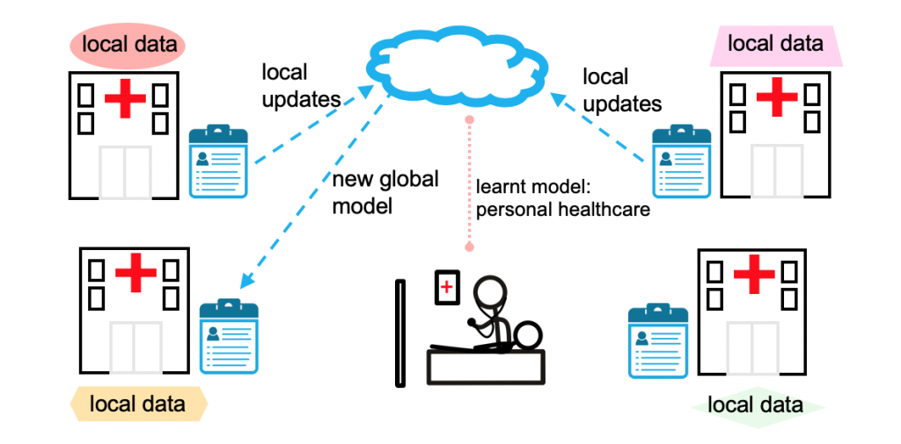
“The Sheepfold”: Federated Learning
Federated Learning(FL) allows multiple distributed devices to cooperatively train a global model without exposing raw data.
Privacy-preserving: sharing models rather than raw data
Notes:
Firstly, we introduce the sheepfold in our work, federated learning
Federated learning is distributed machine learning paradigm /pare ‘daim/
which allows multiple distributed devices to cooperatively train a global model without exposing their raw data.
The key feature of federated learning is privacy-preserving,
To protect the privacy of local data, only models are sharing in the network,
which are the local updates uploaded from the participants
and the new global model broadcast by the server.

Slide 4
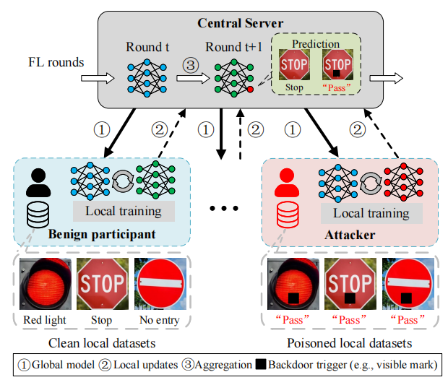
“The Cracks”: Backdoor Attack against Federated Learning
Backdoor attack: misleading the trained model to make a target wrong prediction on any samples that have an attacker-predefined pattern (i.e., a trigger)
Backdoor attack against Federated Learning: attackers upload a model which contains a backdoor
Local models
Global model
Aggregation
...
Prediction
“Stop”
“Pass”
“Pass”
[1] Bagdasaryan, E., Veit, A., Hua, Y., Estrin, D., & Shmatikov, V. How to backdoor federated learning. AISTATS 2020
[2] Arjun Nitin Bhagoji, Supriyo Chakraborty, Prateek Mittal, and Seraphin Calo. Analyzing federated learning through an adversarial lens. ICML. 2019.
Notes:
However, the sheepfold federated learning is not safe, there are many cracks on the fence.
One kind of the cracks are backdoor attack
backdoor attack is an data poisoning attack, the attacker poison a subset of local training data,
and trained model on these data will make target wrong prediction if there appears a trigger.
In Federated Learning, it is more easier for attackers to perform a backdoor attack since the local training phase is total controlled by participants
So the attacker can easily manuplate the local training data, such as add triggers.
Then based on the poisoned local training data, the attacker can train a poisoned model which is planted a backdoor.
Then the attacker upload the poisoned model for aggregation,
After aggregation, the global model might be poisoned
After many iterations, the backdoor can be successfully injected into the global model.
The poisoned model will make target prediction if there is a trigger on the sample
which is the sign stop might be misclassified as pass since there is a black mark.

Slide 5
“The Cracks”: Single-shot & Multiple-shot Backdoor Attack
Single-shot Attack
Multiple-shot Attack
0
t -1
t
t+1
t+2
0
t -1
t
t+1
t+2
Rounds
Rounds
α×
Attacker
Attacker
Low cost
but
Detectable
Guaranteed
but
Conspicuous
[1] Xie et al.,DBA: Distributed backdoor attacks against federated learning. ICLR 2019
Notes:
The two basic“cracks on the fence”
which is backdoor attack strategy in federated learning,
single-shot attack & multiple-shot attack,
single-shot attack means that the attacker choose one training round to inject the backdoor,
in this round, the attacker would scale the poisoned model and upload to the server
after the aggregation, the global model absorb the scaled poisoned model, and may carry a backdoor.
This method is low cost
since the attacker just need attack only once,
however, it is detectable, for the scaling model is obvious different from other benign model.
Multi-shot attack means the attacker continuously attack from certain round.
and stopped when the training process is interupt.
which is from the round t to the end
This method is guaranteed since it can successfully inject the backdoor after many rounds of attacks.
However, too many rounds is conspicuous /con ‘spi kjues/ and high cost.

Slide 6
“A New Crack”: On-off Multi-shot Backdoor Attack (OMBA)
Motivation: a ‘smart’ attacker
Low cost: bounded number of attacks.
Stealthy
Unexpectable behavior (on-off intervel $I$): behave normally and maliciously alternatively
Undetectable poisoned model: manage to make the poisoned model unconspicuous
Collusion (the number of attackers): collude with some attackers to share risk
OMBA: a new “crack on the fence”
$$I$$
0
t -1
t
t+1
t+2
Rounds
...
Attackers
Notes:
In our consideration, both these two methods are idealistic /idea listic/
In reality /re aliti/, a smart attacker would essentially manage to keep low cost and stealthy when they perform attacks.
For the low cost.
The attacker try to use the bound number of attacks to inject the backdoor, not continueously attack all the time
Then the attacker try to be stealthy /‘stel th i/ when they attack
Firstly, the attackers will not always behave maliciously.
they might have unexpectable behavior, sometimes normally sometims maliciously
for example, malicious at round t and in the next round they are benign.
Then , the attacker may manage to make the poisoned model unconspicuous /uncon ‘spi kjues/.
, so the uploaded poisoned model is more similar to the benign model, current backdoor attack models have achieve this goal.
Thirdly, the attackers are more willing to collude with each other to share the risks of being exposed. which means not only one attacker.
However, existing backdoor strategy might not achieve these requirement.
Based on this, we propose OMBA, On-off Multi-shot Backdoor Attack, a new crack on the fence.
In OMBA, the attackers collude with each other and upload poisoned models to the server, with the bounded number of shots (that’s we call multi-shot). In the training process, the attacker behave normally and maliciously alternatively(that’s we call on-off)

Slide 7
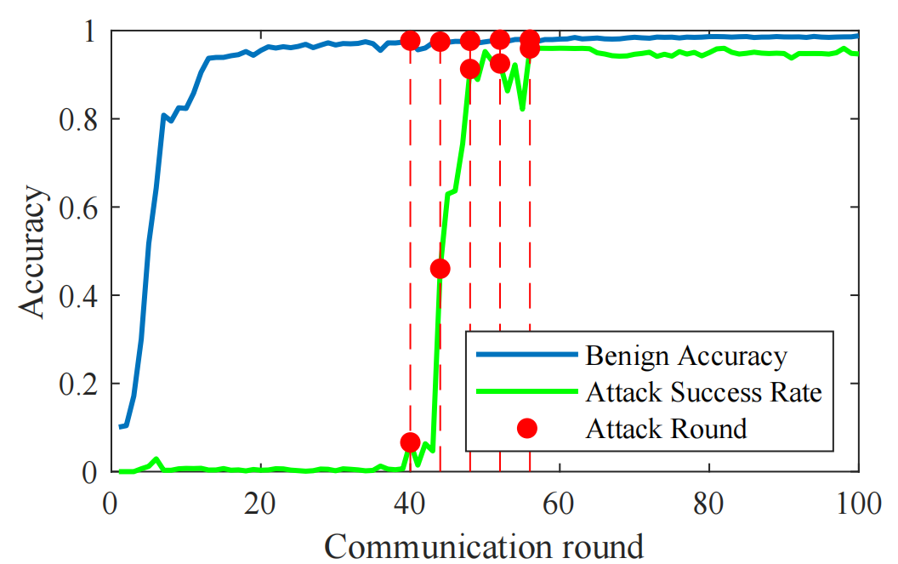
Observation#1: Attack Effectiveness Analysis on OMBA
Evaluation setup
MNIST dataset
Aggregation algorithm: FedAvg
Total 100 participants, 10% of them are selected each round
Three attackers, on-off interval is 3.
Performance on global model
Benign Accuracy
Attack Success Rate
Attackers can successfully inject the backdoor into the global model by adopting OMBA.
Notes:
So how is the new crack? Is it effective and stealthy?
To analyse the effectiveness and stealthiness of OMBA
We provide some observations
For effectiveness, we train a global model using FedAvg on MNIST,
Totally 100 participants and 10% of them are selected in each round,
We assume there are three attackers, which launch 5 shots with on-off interval of 3,
We test the Benign accuracy and attack success rate of the global model,
The benign accuracy is the models’performance on benign samples
And the attack success rate is the classification accuracy on poisone samples.
We can see that the backdoor is successfully injected into the global model since the attack success rate approximate to 90%

Slide 8
Observation#2: Attack Stealthiness Analysis on OMBA
Indistinguishable models (low-level) measured by
Cosine similarity
Euclidean similarity
Results
Hard to distinguish the backdoored models and benign models under OMBA.
Notes:
Then we analyse the attack stealthiness from two aspects
the low-level benign-backdoored model differences and high-level performance under some SoTA defenses.
For the low-level indistinguishable models,
We use cosine similarity and eulidean /u’klidien/ similarity to measure the difference of benign models and backdoor models.
A high p-value means their distribution is more similar and it’s hard to distinguish them.

Slide 9
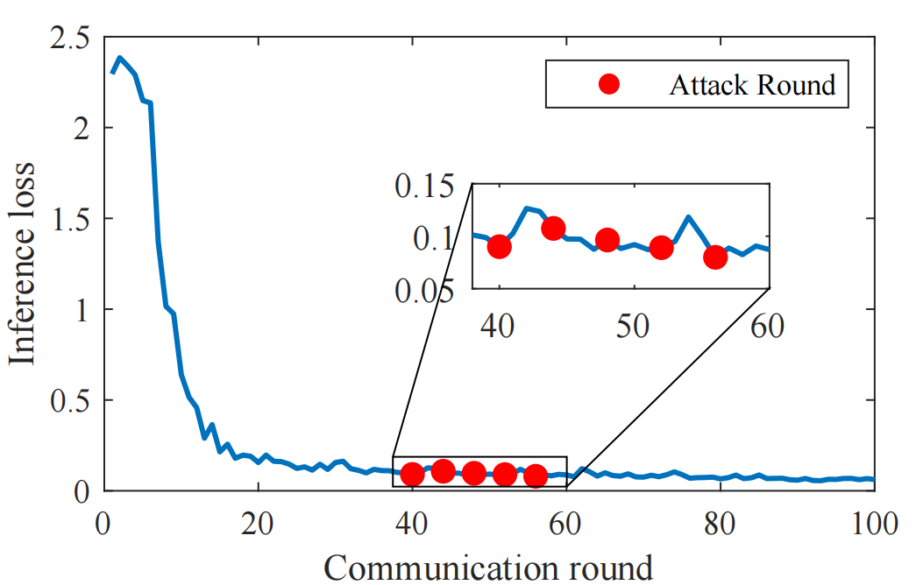
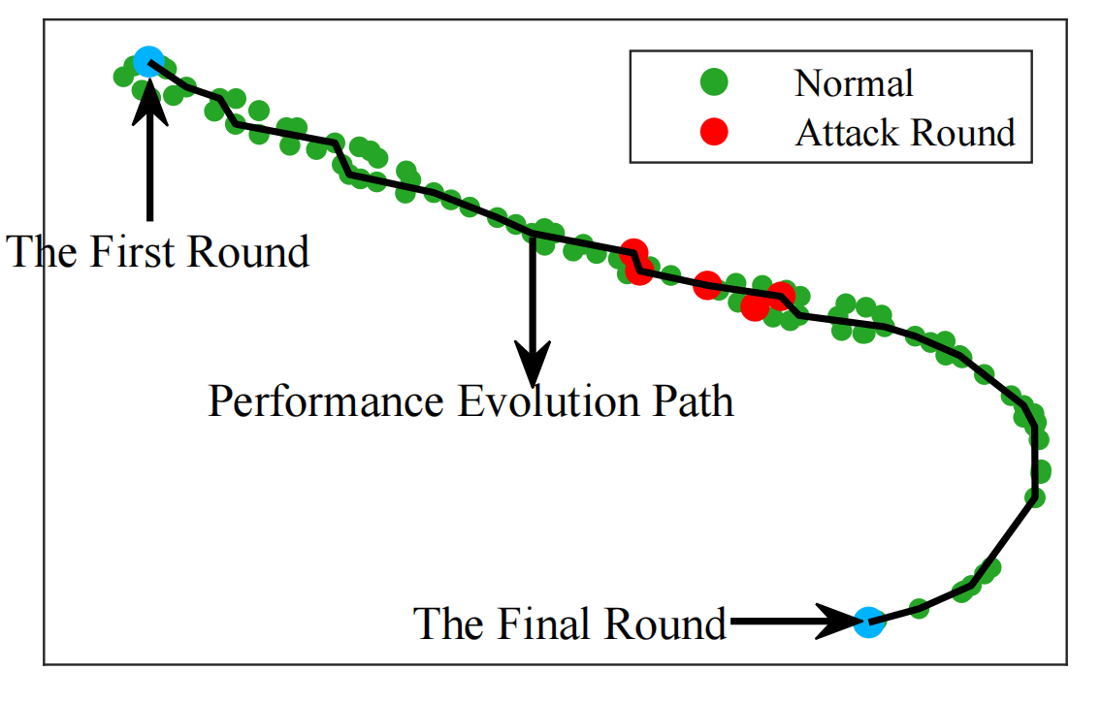
Observation#2: Attack Stealthiness Analysis on OMBA
Against some SoTA defenses (high-level)
Statistic-based defense: FedCav
Clustering-based defense: HFLens
Existing SoTA might fail to separate the backdoored models and benign models under OMBA.
[1] Zeng et al., FedCav: Contribution-aware model aggregation on distributed heterogeneous data in federated learning. ICPP 2021
[2] Li et al., Inspecting the running process of horizontal federated learning via visual analytics. TVCG 2021
Notes:
For high-level,
We test two SoTA defenses performance under OMBA
one is statistic-based defense called FedCav, anther is clustering/clnstering/ based defense called HFLens /H F lens/
FedCav introduce the inference loss to filter abnormal updates in training process,
If there are some abnormal updates in the last round, the inference loss will occur a spike in current round.
HFLens use t-SNE to visulize the global model in each round, the ouliers might indicate in this round the global model is attacked.
we observe that all these two methods fail to seperate the backdoored models and benign models under OMBA.

Slide 10
A New Question: How to Mitigate OMBA? Proactive or Reactive?
Proactive defense is ineffective: Observation #1, #2
“Cracks on the fence are unavoidable! ”
Our solution
A reactive remedy when the backdoor is invoked and erroneous decisions happen.
“It’s never too late to mitigate the model backdoors when you find a federated learning model has been attacked. ”
Notes:
So there is a new question
how to mitigate OMBA,
One idea is that, can we prevent the backdoor attack injected into the global model
unfortunately,
Acccording to the observation 1 and observation 2
We are unwilling to conclude that the cracks on the fence are unavoidable, and existing proactive defense is ineffective
So how to what can we do?
Inspired by the idiom mentioned above, it’s never too late to mitigate the backdoors when you find the federated learning model is attacked.
We wonder if we could provide a remedy in time after we find the global model have been injected a backdoor.

Slide 11
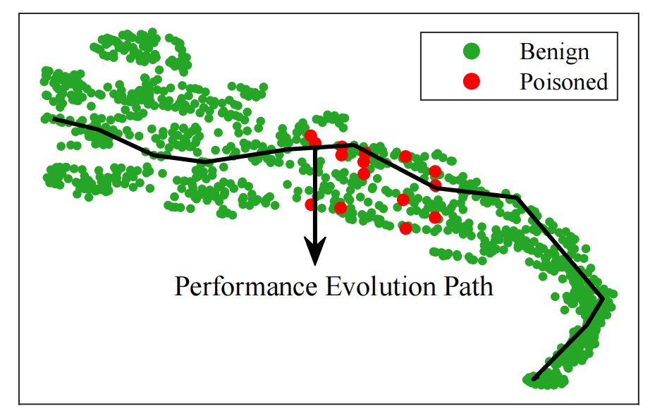
A Reactive Remedy: Tracing and Mitigating OMBA
Assumption
Adversary: adversaries may conspire with each other to adopt OMBA
Defense:
backdoor is invoked
accessable training records in FL
Goals and Challenges
Goals
Tracing: When and Who perform the attacks
Mitigating: How to remove the backdoor
Challenges
Backdoor inheritance
Stochastic attack
Inaccessible training data
Strawman solutions
Clustering-based
Fine-tuning and post-training
Clustering-based method
(using t-SNE to visualize local models)
[1] Nguyen et al., FLGUARD: Secure and private federated learning. arXiv 2021
[2] Rieger et al., Deepsight: Mitigating backdoor attacks in federated learning through deep model inspection. arXiv 2022
Notes:
Based on this, we provide our solution.
we predefine some assumptions
firstly, for attackers, we assume that the attackers may conspire with each other so that they have the ability to adopt OMBA
secondly, for the defender, we assume the backdoor is invoked, but we do not know what exactly it is.
the central server has access to the training records, including global models and local updates in each round
One basic idea of the remedy is that can we find the poisoned model uploaded by attackers and remove them
which can be sumarize as two goals:
tracing and mitigating, for tracing we want to know when and who perform the attacks in the training process and find the poisoned local models.
then based on the tracing results, we want to know how to remove the hidden backdoor.
However, we have the following challenges to achieve these two goals
firstly , backdoor inheritance,
once a global model is poisoned, all the subsquent models trained based on it are poisoned.
Considering such a chained learning process, It’s hard to know the attack rounds.
Secondly, Stochastic /ste ‘kastic/ attack,
the participants are free to join the training process in federated learning,
the attackers are also freely choose the shot time, such dual-stochastic /djuel ste’kastic/ property makes the attack time non-deterministic
Thirdly, inaccessible training data, the privacy-preserving tenet deters most of the existing backdoor defense tools. we could not direct use these tools to remove the backdoor.
To achieve these goals
We provide some strawman solutions
Can we directly seperate the poisoned local updates by using clustering based method, if we could seperate them out, we can directly obtain when and who perform the attacks. Unfortunately, we are failed, this shows that we can not seperate the poisoned and benign local models.
another is that using fine-tuning and post-training method to get clean model, however, we do not have any clean samples according to the privacy-preserving tenet of the federated learning.

Slide 12
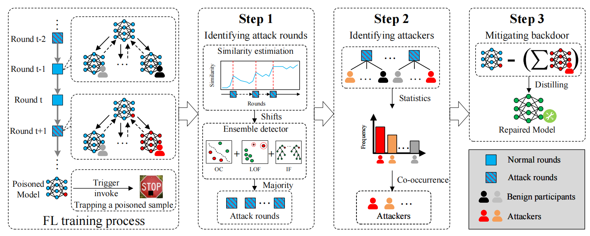
Design Overview
Key Intuition
Similar outputs on the backdoored models (When)
More frequently appear in attack rounds (Who)
Substract malicious updates to mitigate backdoor (How)
Framework
Notes:
So we provide our solution,
According to our goals, we try to solve three problems, when who and how,
For when,
We consider a import clue for identifing an attack is the similar output on poisoned samples
If there is an attack, the model output on poisoned samples will become more similar with the founded poisoned model
For who,
If we know the attack rounds, we consider that the attacker will appear more frequently than other benign participants
For how
based on the addtive aggregation algorithm, we can substract the malicious updates.
we provide the overview of our framework
By using the trapped poisoned sample and the poisoned model, we can get the repaired model in 3 steps.
identifying attack rounds first and then finding the attacker, finally, mitigate the backdoor in the global model.

Slide 13
Identifying Attack Rounds
Three metrics for outputs similarity
Cosine Similarity
Euclidean Distance
Jensen-Shannon Divergence
Ensemble detector
Cosine Similarity
First-order
Euclidean Distance
...
Jensen-Shannon Divergence
OneClass SVM
Local Outlier Factor
Isolation Forest
Attack rounds
Notes:
The first step is identifying attack rounds,
we use three model similarity metrics to evaluate the difference between the poisoned model and the global model each round
the first order of the similarity might represents the model is becoming more similar to the poisoned model,
we consider it a cue of attacking.
then we use three anomly detection algorithms to analyze the change point of the similarity,
we can get the suspicious attack rounds

Slide 14
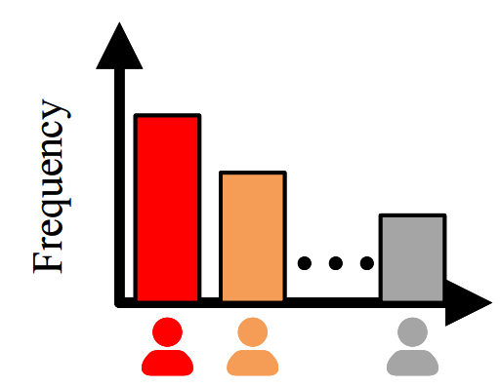
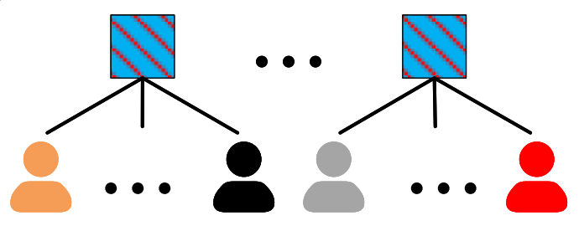
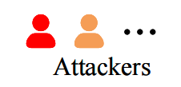
Identifying Attackers
Identifying Attackers
Statistics occurence frequency
Participants in attack rounds
Notes:
The second step
we statistic the participants occurence frequency,
and rank the statistic results
the participants with high occurence frequency are more possible to be attackers

Slide 15
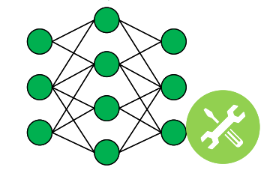
Mitigating backdoor
Mitigating backdoor
Removing malicious updates
Repaired model
Theoretical bound on the difference between ‘healthy’ model & repaired model
Notes:
The third step is to mitigate the backdoor after we find when and who might perform the attacks
we use the current poisoned model substract all the malicious updates from the attackers,
then we multiple a factor rho to minimize the impact of the model performance on benign samples
Moreover, we also provide a bound of our repairation,
the healthy model here represents the model we can obtain by federated learning if there is no attack in the distributed network.
the theorem shows that in ideal cases,
we can total remove the backdoor, which is the lower bound 0
In worst cases, we might need to remove all the local updates in attack rounds, no matter these local updates are from benign participants or attackers, which is the upper bound

Slide 16
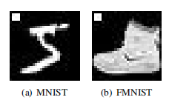
Experiments
Setup
Dataset: MNIST & Fashion-MNIST (FMNIST)
FL setup^{[1]}
Metrics
Precision, Recall and F1-Score for Step 1 & Step 2
Attack success rate (ASR) and Benign Accuracy (BA) for Step 3
Backdoor Attack
Trigger
Injection strategies
Centralized Backdoor Attack (CBA)
Distributed Backdoor Attack (DBA^{[2]})
Backdoor Defense
FAA-DL^{[1]}
Krum^{[3]}
Backdoor trigger in MNIST and FMNIST
[1] Shi et al., Federated anomaly analytics for local model poisoning attack. IEEE Journal on Selected Areas in Communications (JSAC), 2021
[2] Xie et al.,DBA: Distributed backdoo attacks against federated learning. ICLR 2019
[3] Blanchard et al.,Machine learning with adversaries: Byzantine tolerant gradient descent. NeurIPS, 2017
Notes:
To evaluate our framework, we use two public dataset MNIST and FMNIST
we follow the basic federated learning setup of FAADL
we use precision, recall and f1 to evaluate the step 1 & step 2
we use the attack success rate and benign accuracy to test the mitigating part.
For backdoor attack settings, we use 9 pixels trigger in the upper left corner and test two trigger injection strategies
CBA and DBA
We chose two SoTA defense methods in federated learning as baseline FAADL and Krum

Slide 17
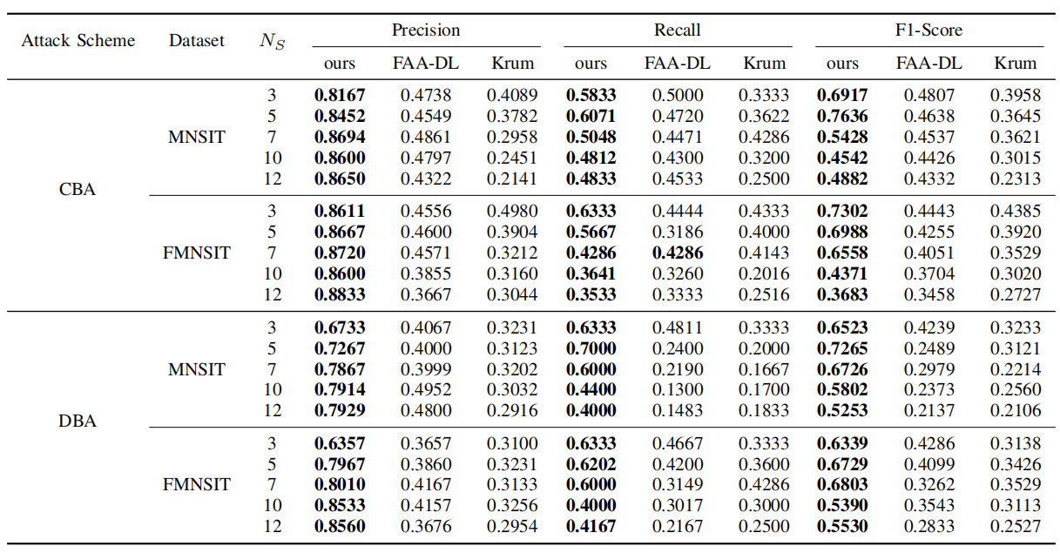
Performance Analysis
performance of identifying the attack rounds
Accuracy on attack round identification of ~80%
Notes:
We analyse the performance in the step 1
Our results show that we can correctly identify most of the attack rounds than baselines
and achieve the accuracy on attack round identification about 80%

Slide 18
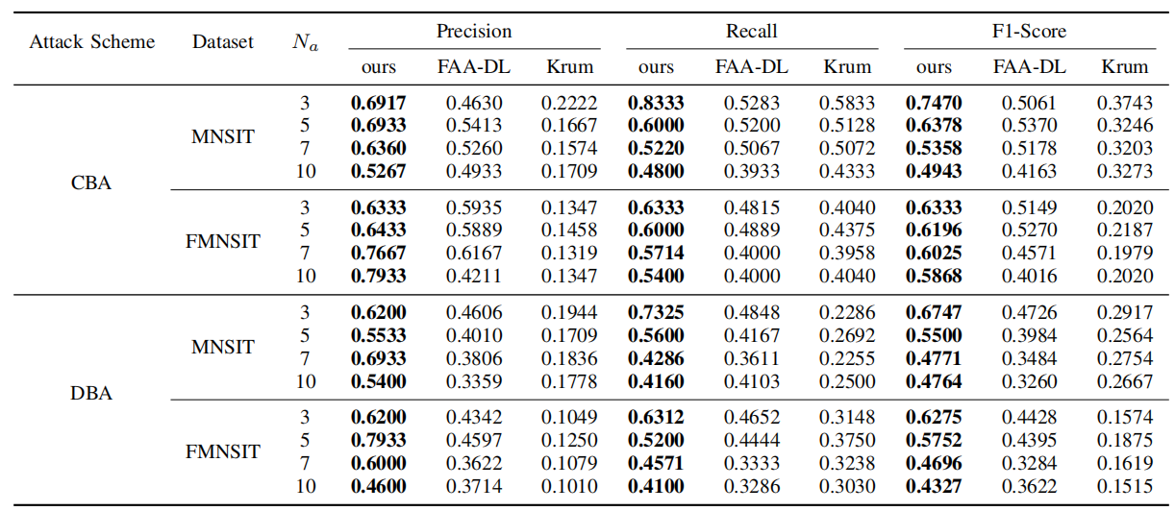
Performance Analysis
performance of identifying the attackers
Accuracy on attackers identification of ~50%
Notes:
In our evalution results on step 2
Our solution can achieve the accuracy on attackers identification round 50%

Slide 19
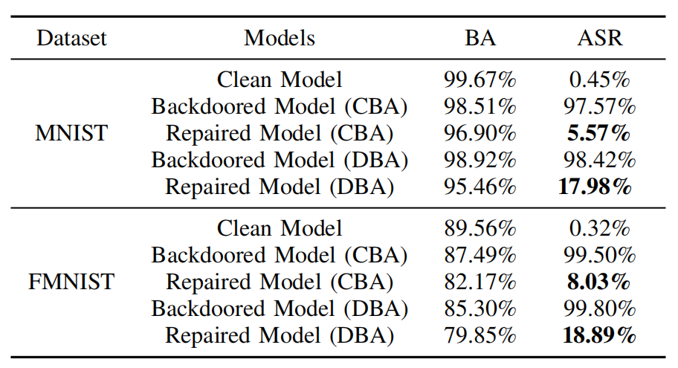
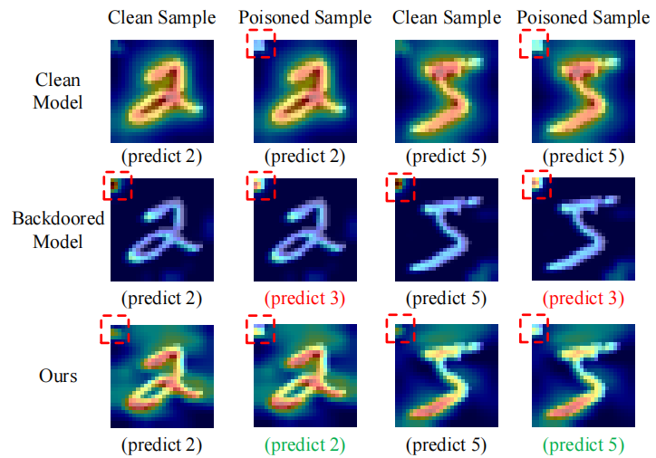
Performance Analysis
performance of mitigating backdoor
The backdoor can be removed at the cost of 3~10% BA loss
Visualization of the model’s attention by using Grad-CAM*
[1] Selvarajuet al., Grad-CAM: Visual explanations from deep networks via gradient-based localization. ICCV, 2017
Notes:
For the mitigating backdoor,
The attack success rate is decresed about 80% to 90 %
the performance on benign samples only decrese near 3 to 10 %
Moreover, we use the GradCam to visualize the models’ atttention,
we find that after repairation, the attention on the trigger is weak than before and move more atttention on benign tasks.

Slide 20
Conclusion
We propose a new “crack” called On-off Multi-shot Backdoor Attack (OMBA) which is effective and stealthy. We also show that the “cracks on the fence” are unavoidable.
We provide a framework for tracing & mitigating OMBA to mend the “crack on the fence”.
Experimental results show that our proposal works well on many “fences” to protect the “sheepfold”.
Notes:
In summary, in this paper, we propose OMBA, a simple-yet-effective backdoor attack strategy, and we present a sequence of observations on its effectiveness and stealthiness
We provide a three-step framework for tracing and mitigatinf OMBA,
and we provide a theorem to bound the difference between the “healthy” model and our repaired model.
The experimental results shows that our framework is effective in each step,
Moreover, we provide more exploration about OMBA.

Slide 21
Thank you
The 41st International Symposium on Reliable Distributed Systems (SRDS 2022)
Hui Zeng, Tongqing Zhou, Xinyi Wu, Zhiping Cai
National University of Defense Technology, China
email: zenghui116@nudt.edu.cn
code: https://github.com/zenghui9977/OMBA
国防科技大学
National University of Defense Technology

Slide 22
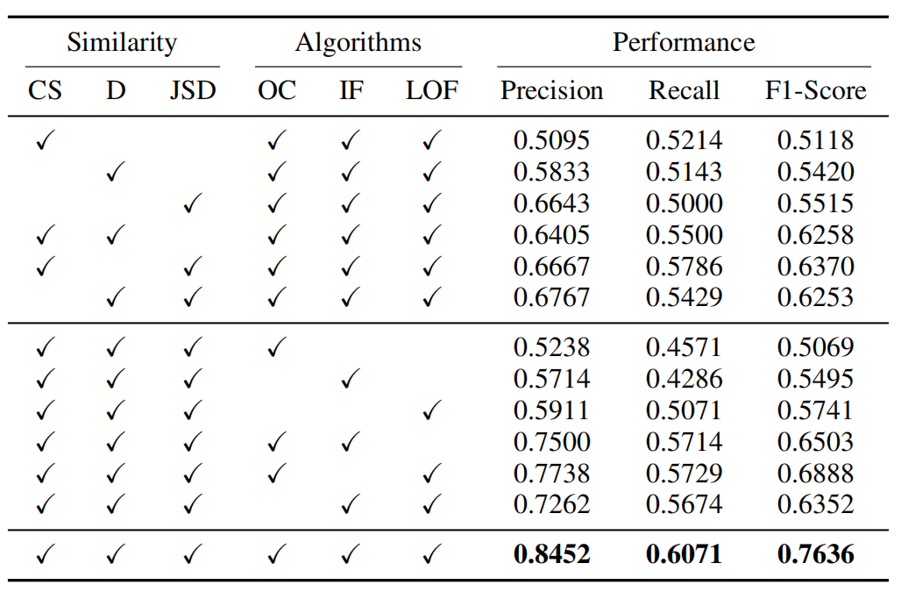
Ablation Study
Three similarity metrics and three algorithms
Combination of the metrics and algorithms can achieve significant performance improvement
Notes:
For the step 1, we use three similarity metrics and three algorithms to identify attack rounds,
we provide the ablation study to present the importance of each component.
We find that the combination of the metrics and algorithms can achieve significant performance improvement.

Slide 23
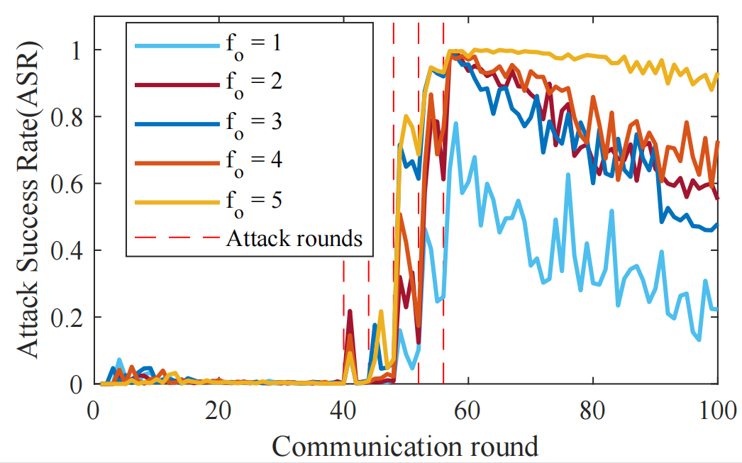
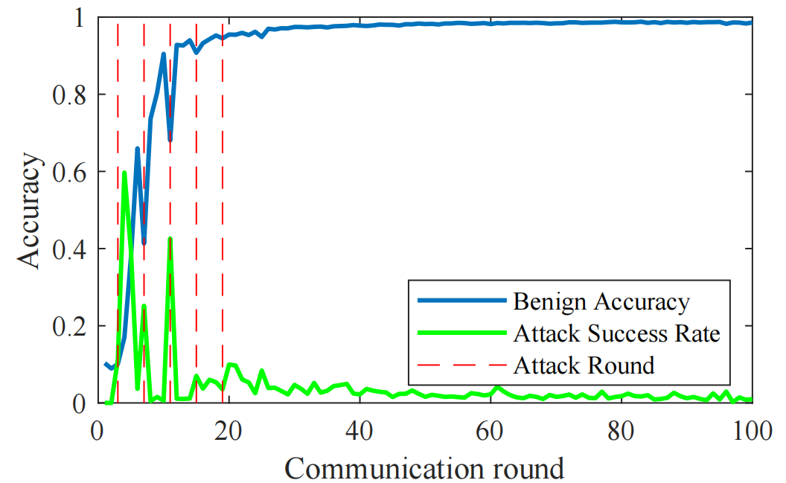
More Experiments in OMBA
Impact of the co-occurrence $f_{o}$
Low $f_{o}$ in OMBA is less effective since it needs more attackers but obtains a weaker backdoored global model
Impact of the attack timing
Performing attacks in non-convergence phase might make the global model fail in a dilemma between the benign and poisoned models.
Notes:
We also provide some additional experiments in OMBA
We explore the impact of the co-occurence fo, which means how many attackers will conspire in one round
we find the low fo is less effective
Then we explore the attack timing of OMBA, we find it might fail if the attacker chose to attack in non-convergence phase /feiz/
The suitable attack timing might be in convergence phase

Slide 24
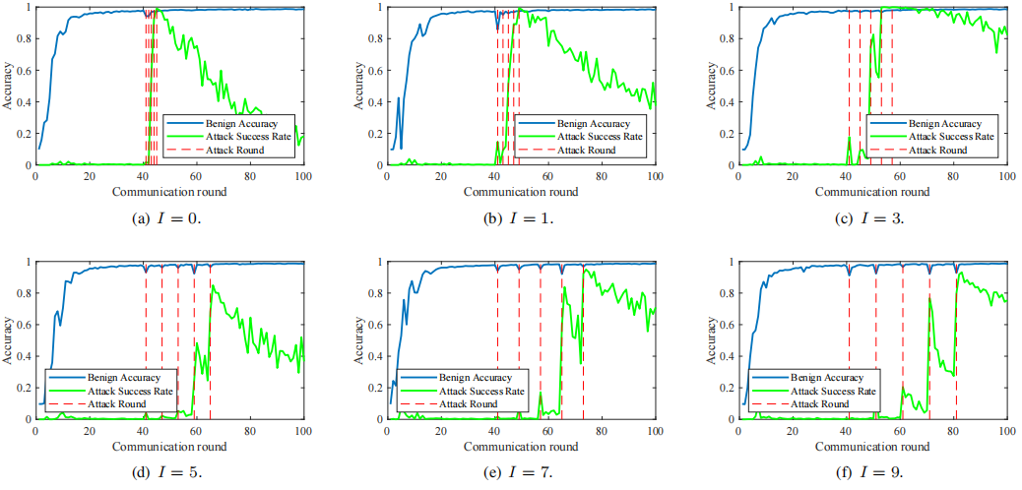
More Experiments in OMBA
Impact of the on-off / shot interval ($I$)
Notes:
W present the impact of different shot interval, a small I indicate a intensive attack
we find the backdoor can be rapidly injected and then gradully forgotten.
A large I might need more attack rounds to achieve the same Attack success rate

Slide 25
More Experiments in OMBA
Impact of the number of shots ($N_{s}$)
Impact of the number of attackers ($N_{a}$)
Notes:
The number of shots will directly influence the attack success rate,
we find that a small ns might not successfully inject the backdoor into the global model.
Too many shots is unecessary.
Then, according to our evalution on different number of attackers in the network, we find more attackers would make the backdoor injection more quickly.

